Slide 1
Conditional Temporal Neural Processes with Covariance Loss
Boseon Yoo¹, Jiwoo Lee², Janghoon Joo², Seijun Jung¹, Soyeon Kim¹
and Jaesik Choi^{1,3}
¹Graduate School of AI, KAIST, Republic of Korea.
²Department of Computer Science and Engineering, UNIST, Republic of Korea.
³Ineeji Incorporation, Republic of Korea.

Slide 2






















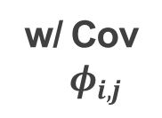









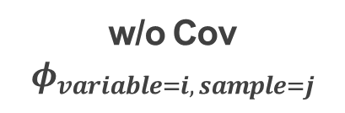






Key Idea
Variable N
Sample $j$
w/o Cov
$$φ_{variable=i, sample=j}$$
w/ Cov
$φ_{i,j}$
…
Variable 1
$$y_{i, j}$$
$$\hat{Y}$$
$$φ_{1,1}$$
$$y_{1,1}$$
$$φ_{1,1}$$
$${\hat{y}}_{1,1}$$
$$X_{1:T}$$
$$y_{T+1:2T}$$
$$φ_{1,2}$$
$$y_{1,2}$$
$$φ_{1,2}$$
$${\hat{y}}_{1,2}$$
$$×$$
$$W$$
$$=$$
$$φ_{1,3}$$
$$y_{1,3}$$
$$φ_{1,3}$$
$${\hat{y}}_{1,3}$$
A Temporal DNN
$$φ_{1,4}$$
$$y_{1,4}$$
$$φ_{1,4}$$
$${\hat{y}}_{1,4}$$
Sample size
($b$)
$$b$$
$b$ $×$ $N$
$$b$$
Variable size
($N$)
$$Φ(X)$$
$$N$$
$$Y$$
$$argmin$$
$$Φ$$
(Original loss function) +
$$Φ\left(X\right)Φ{\left(X\right)}^{⊤}$$
$${YY}^{⊤}$$
Basis function
feature size ($F′$)
Output time step size ($T$)
× Output feature size ($S$)

Slide 3
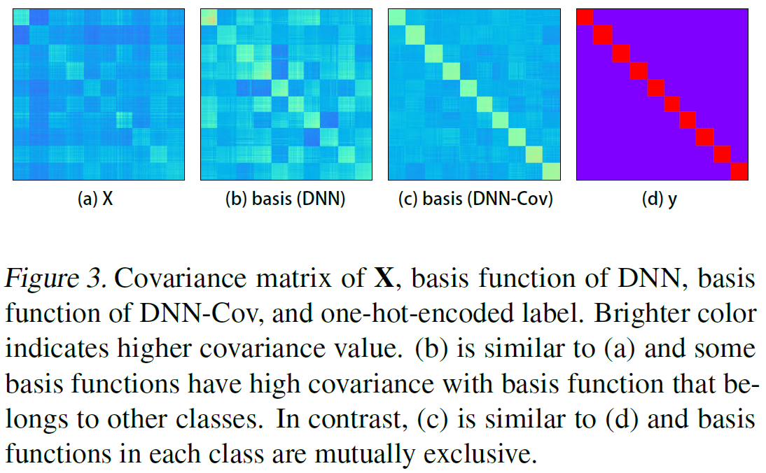
Result - Classification

Slide 4
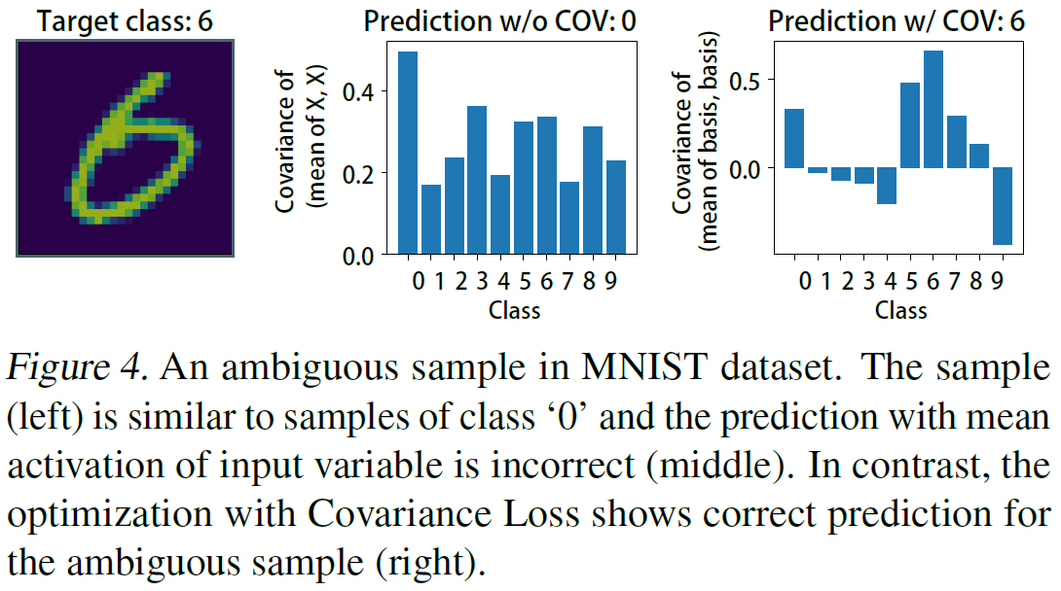
Result - Classification

Slide 5
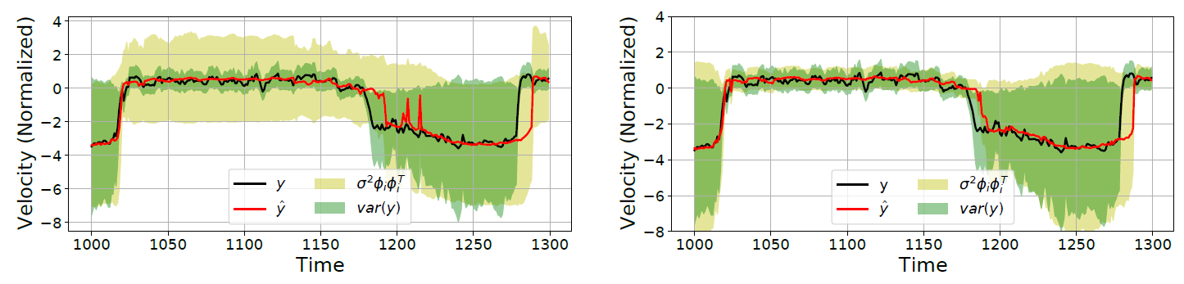
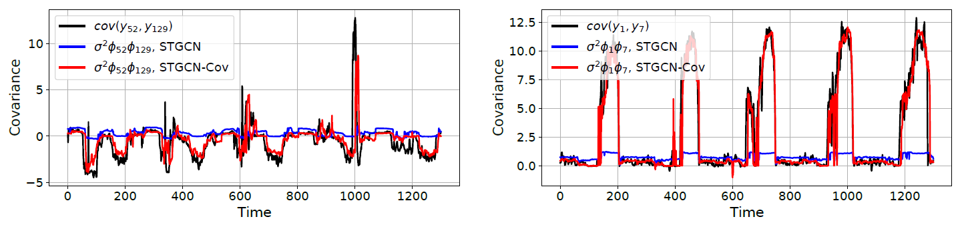
Result - Regression

Slide 6
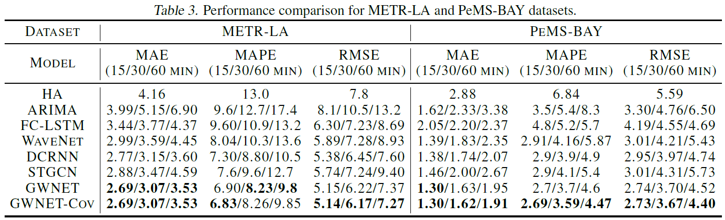
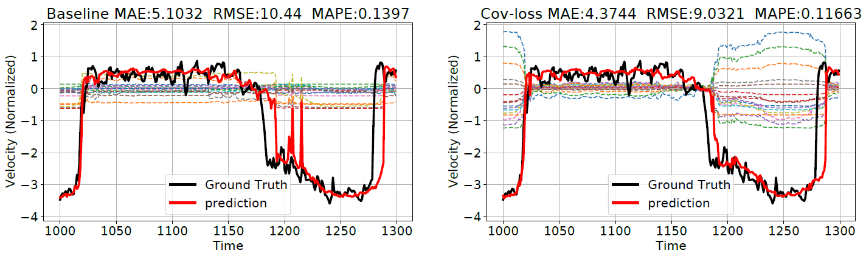
Result - Regression

